Slide 1
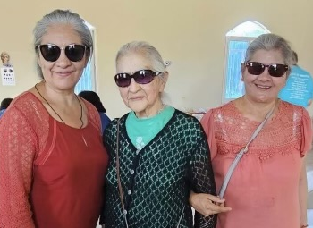
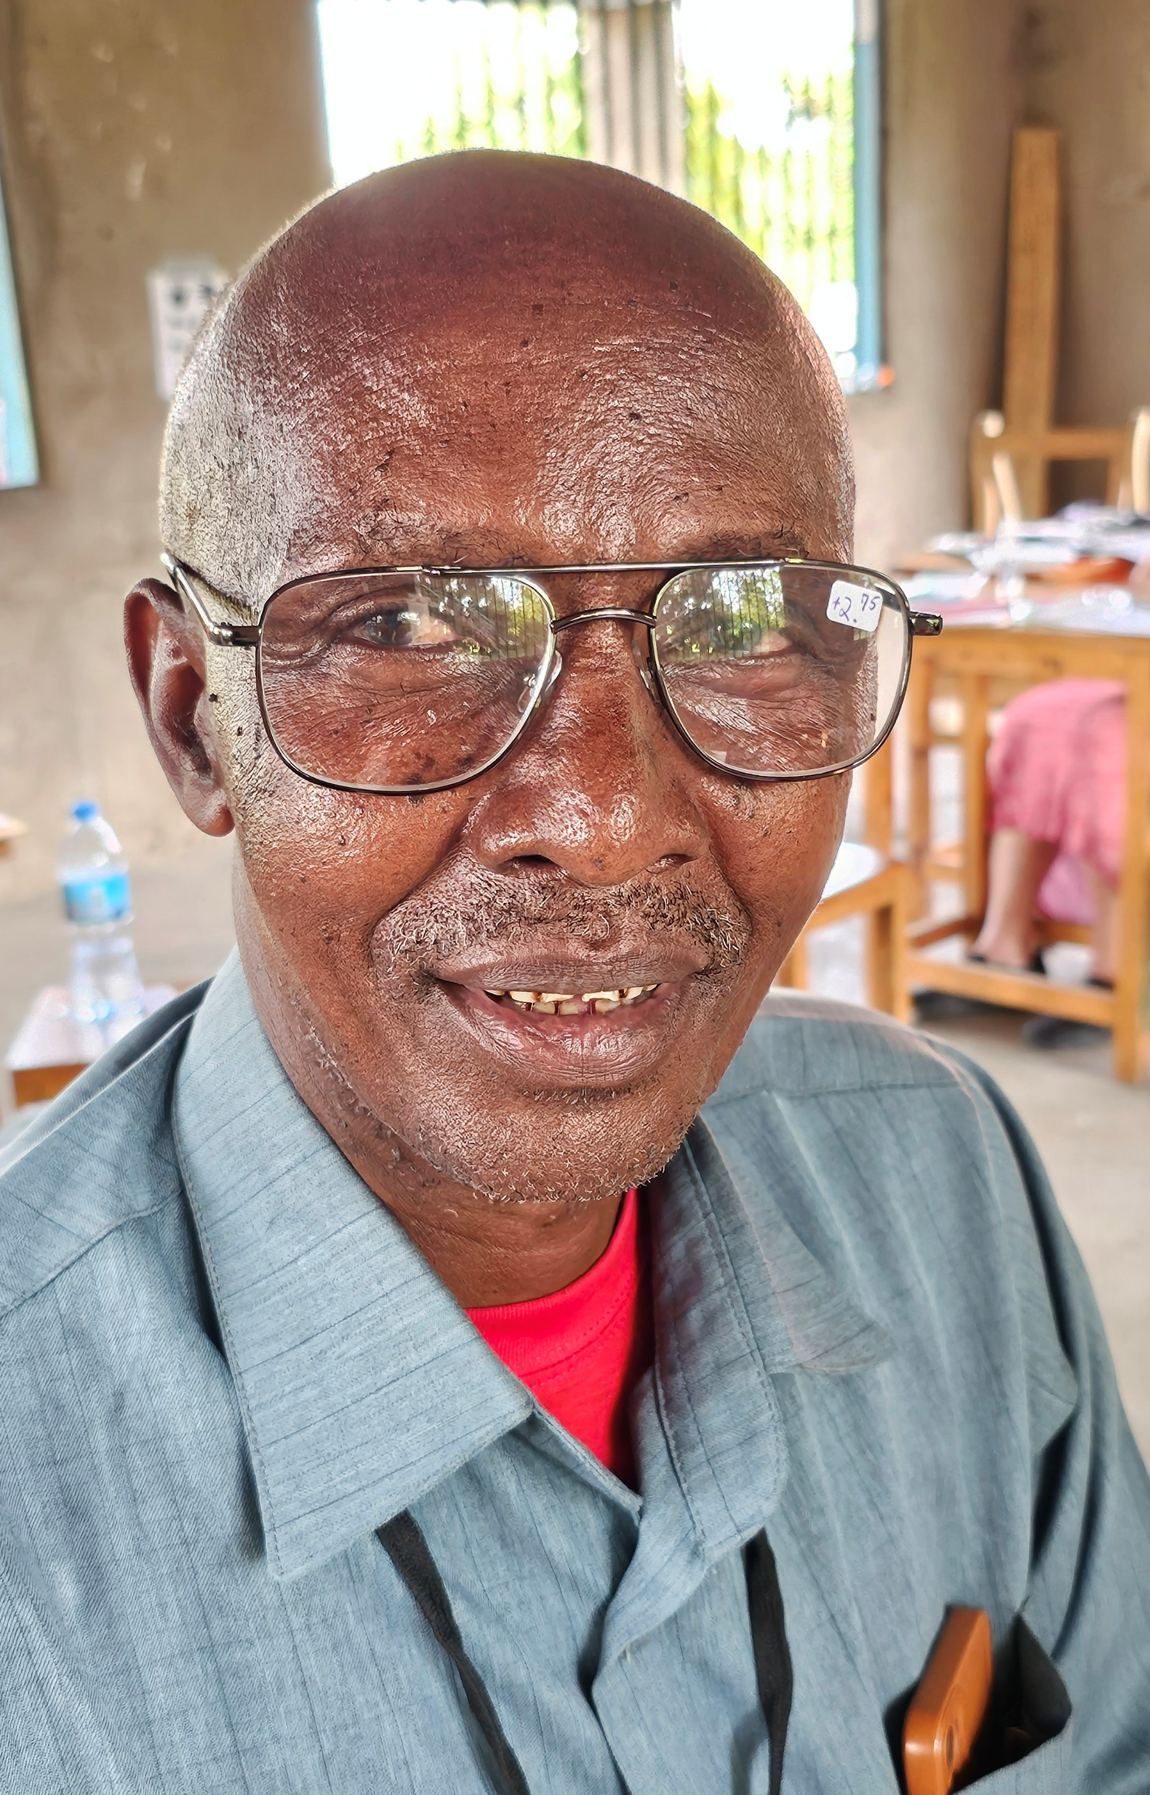
MOST Ministries
Eyeglass Collection
How to get involved:
Collect prescription eyeglasses and non-prescription sunglasses
For more information, visit mostministries.org
About 2.2 billion people have vision impairment; 1 billion have vision impairment that could have been prevented – Eyeglass teams are MOST’s #1 requested team project

